Slide 1
Andras’ War Book of Accolades
Professional Portfolio by Andras V. Cruz-Aedo

Slide 2
Web Design & Online Marketing
Summary of Professional Experience

Slide 3
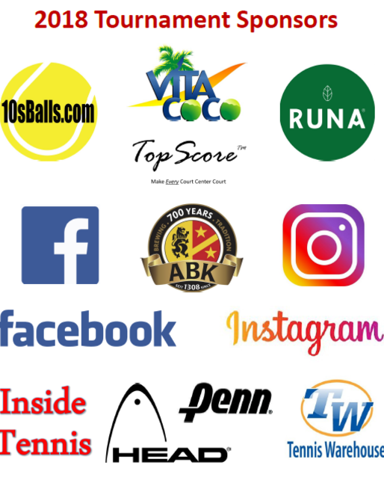
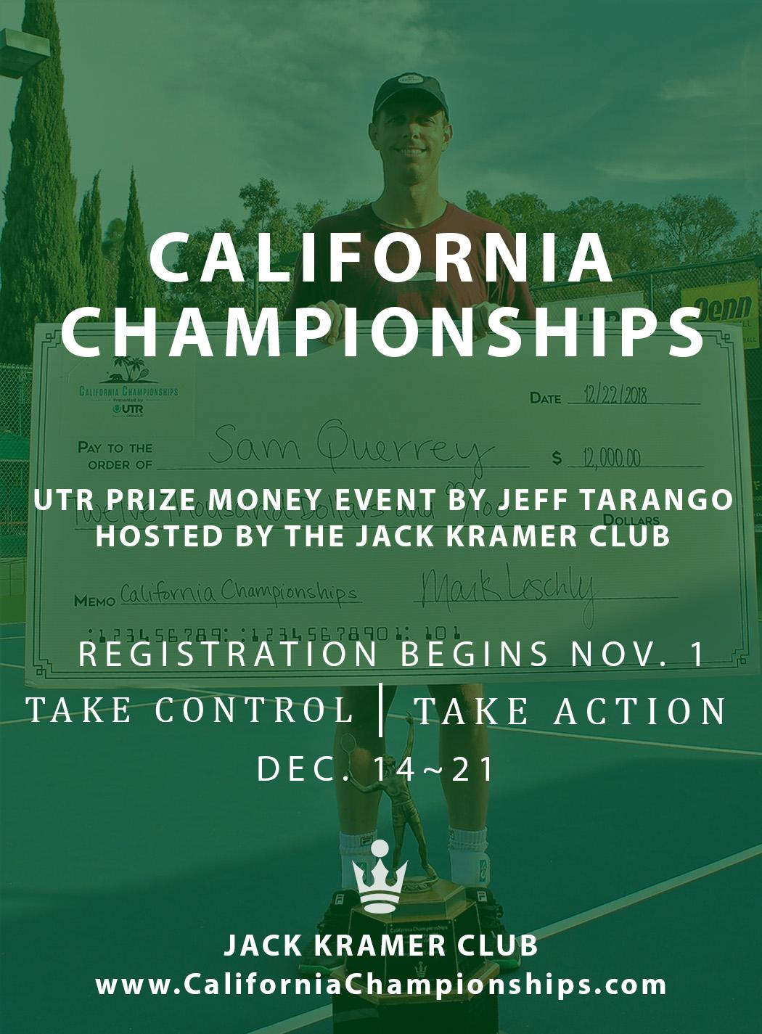
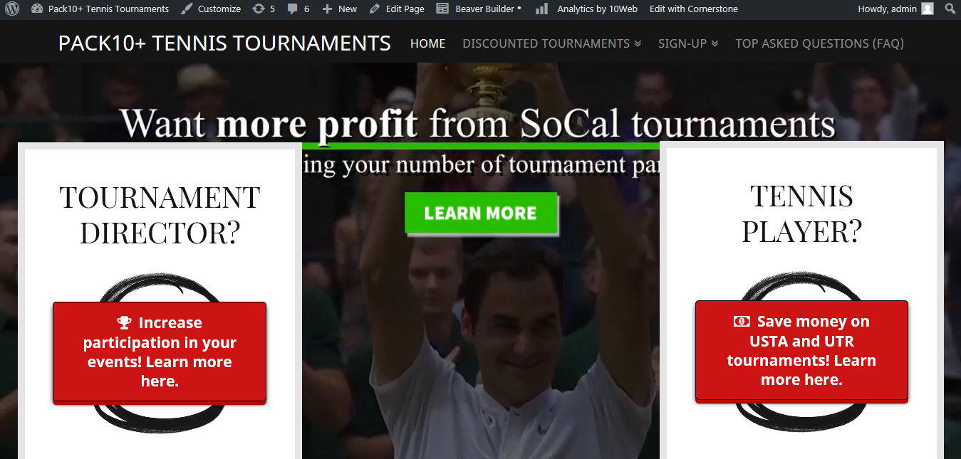
“Life would be tragic if it weren’t so funny” - Stephen Hawking
☆ Designed and developed http://pack10plus.com in 6 days
☆ Designed and developed https://californiachampionships.com in 3 days
☆ Web design, development, and management, professional media design and development, & strategic planning for Wimbledon Finalist and tennis professionals
☆ Web, Social, and Sales Reports for UncleBuds, Sheila E., S-Club Fitness and 12 other clients (previous employer as a current reference; Eric@Extima.com)

Slide 4
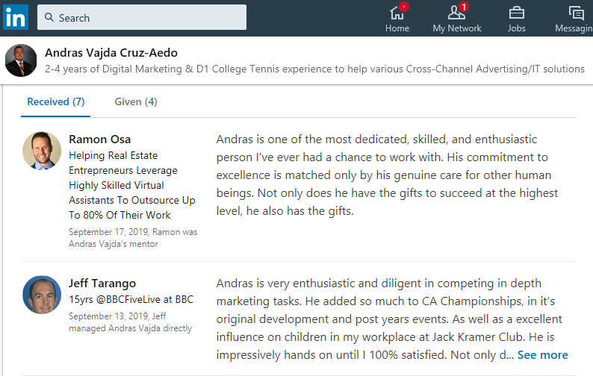
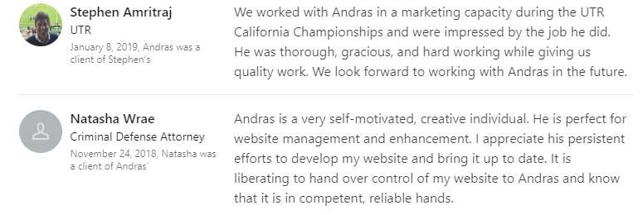
“I don't look to jump over 7-foot bars: I look around for 1-foot bars that I can step over.” - Warren Buffet
☆ Converted a budget of $750 into an ROI of 25,000 viewers on Facebook for client Oracle subsidiary (see reviews bottom right)
☆ Increased Search Engine Results from Top 500 to Top 25 on Google for client Natasha Wrae, Attorney at Law in less than 3 months
☆ Wrote, as a junior in college, the marketing plan to sign a $12,000 investor, and obtain the current mentorship of Bing Chen, Head of Global Product at ABCmouse.com to help me start this web design and online marketing agency to design, develop, and manage Wix, Weebly, and WordPress websites, each optimized for SEO, SMM, PPC

Slide 5
College Tennis Player & Coach
Professional Experience #1

Slide 6
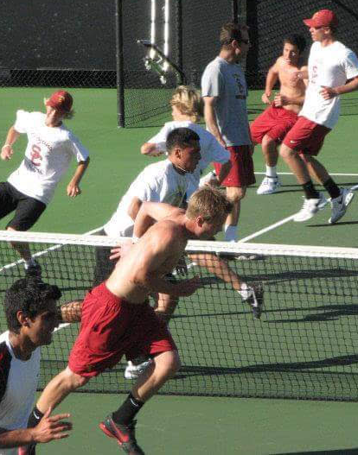
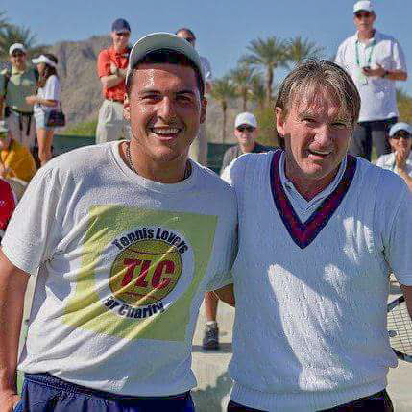
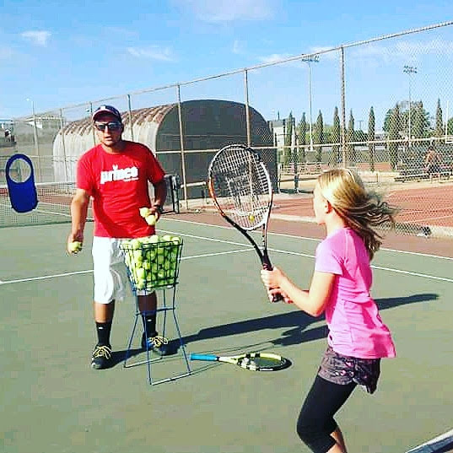

“I've got to keep on working, keep on grinding, and keep on going out there to get better.” - Rob Gronkowski
☆ Began training with USC Trojan’s and tennis legends at South Bay’s Competitive Training Center at age 12
☆ Ranked Top 75 in the 16 & Under division for all of Southern Cal
☆ Ranked Top 300 in the 18 & Under division in the Nation
☆ Varsity Tennis Captain (Highschool) and #1 Mixed Doubles (College)
☆ Volunteer Hitter for University of Arizona’s Wheelchair Tennis
☆ Letter of Recommendation from USC Men’s Tennis Head Coach

Slide 7
Packback Inc.
College Internship

Slide 8
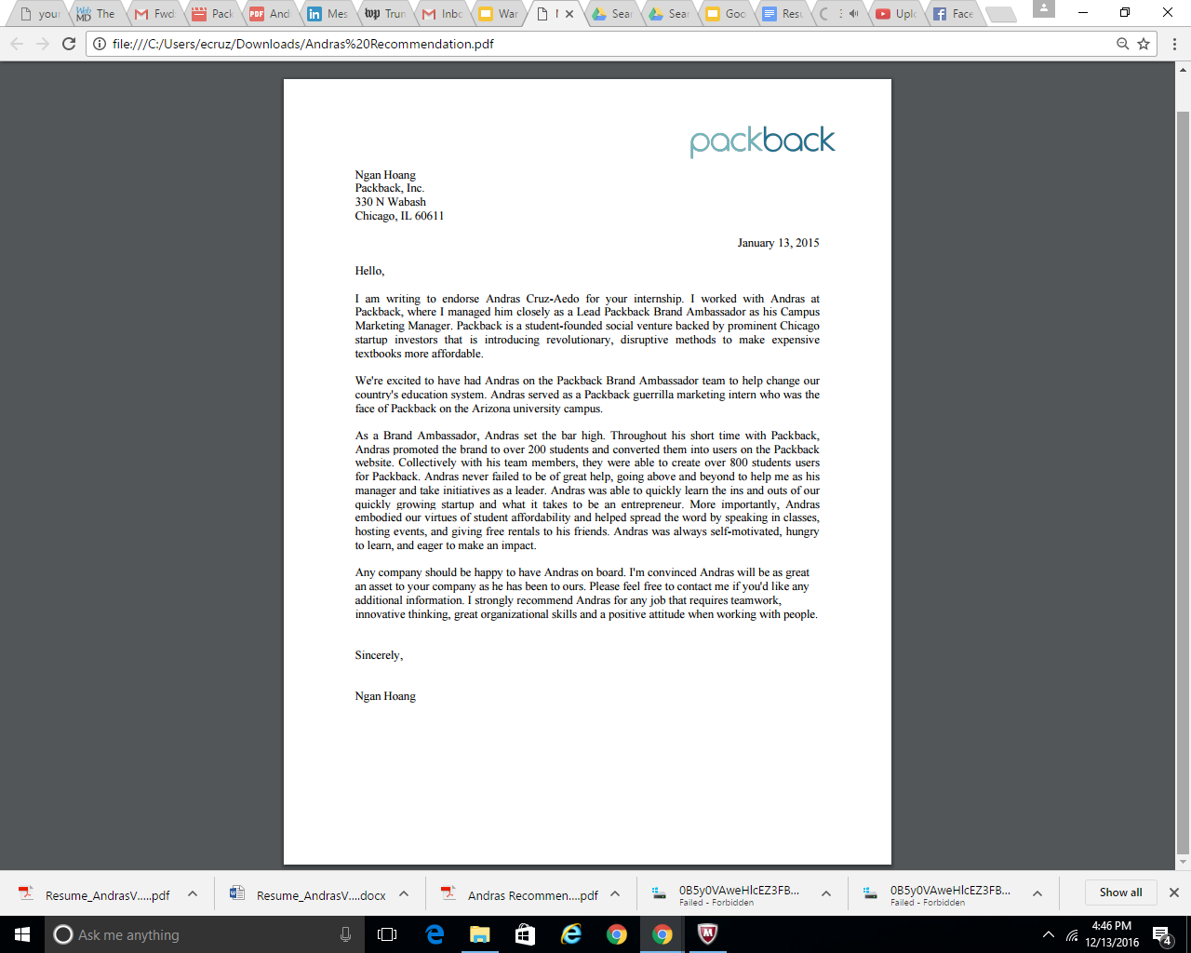
Packback, Inc.: Letter of Recognition
https://drive.google.com/file/d/0B5y0VAweHlcES21JVVdzU28teU0/view?usp=sharing

Slide 9
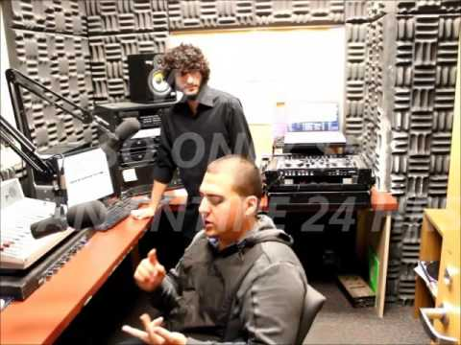
Packback, Inc.: KAMP Radio awareness campaign
A short clip of one of Java In 4 Days LLC's first closed-circuit television productions to provide detailed insight of what we did for Packback e-Text Books as well as DJ Dizzy with KAMP Student Radio (listener base of over 42,000+ student and staff body at the University of Arizona)

Slide 10
Marketing, Sales, and Higher Technology
Professional Experience #2

Slide 11
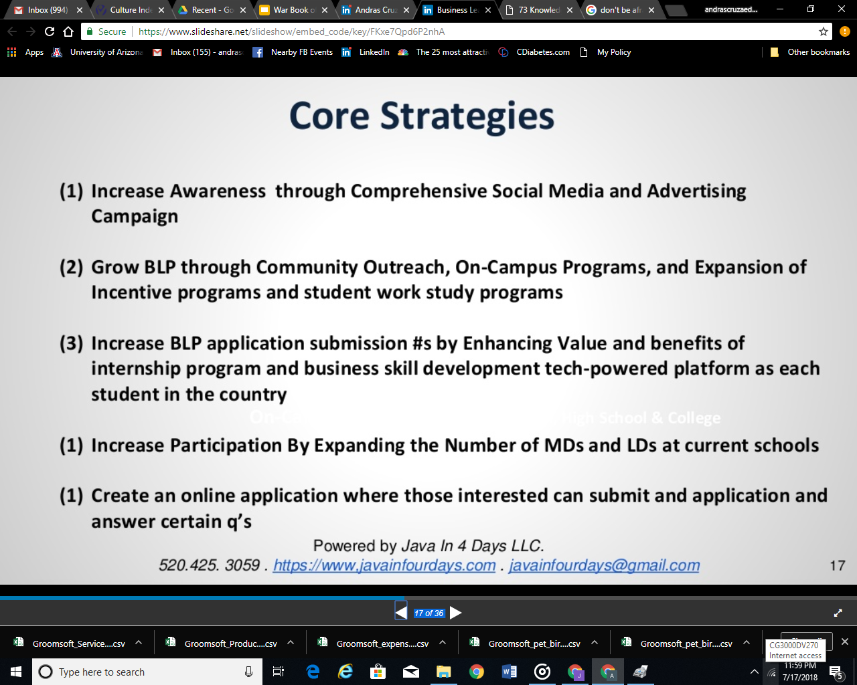
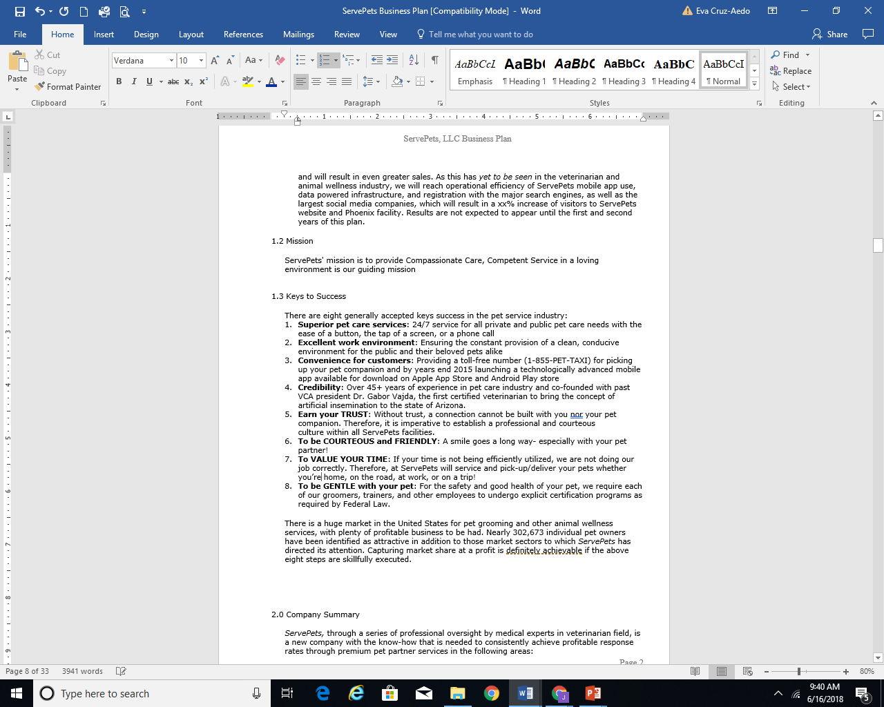
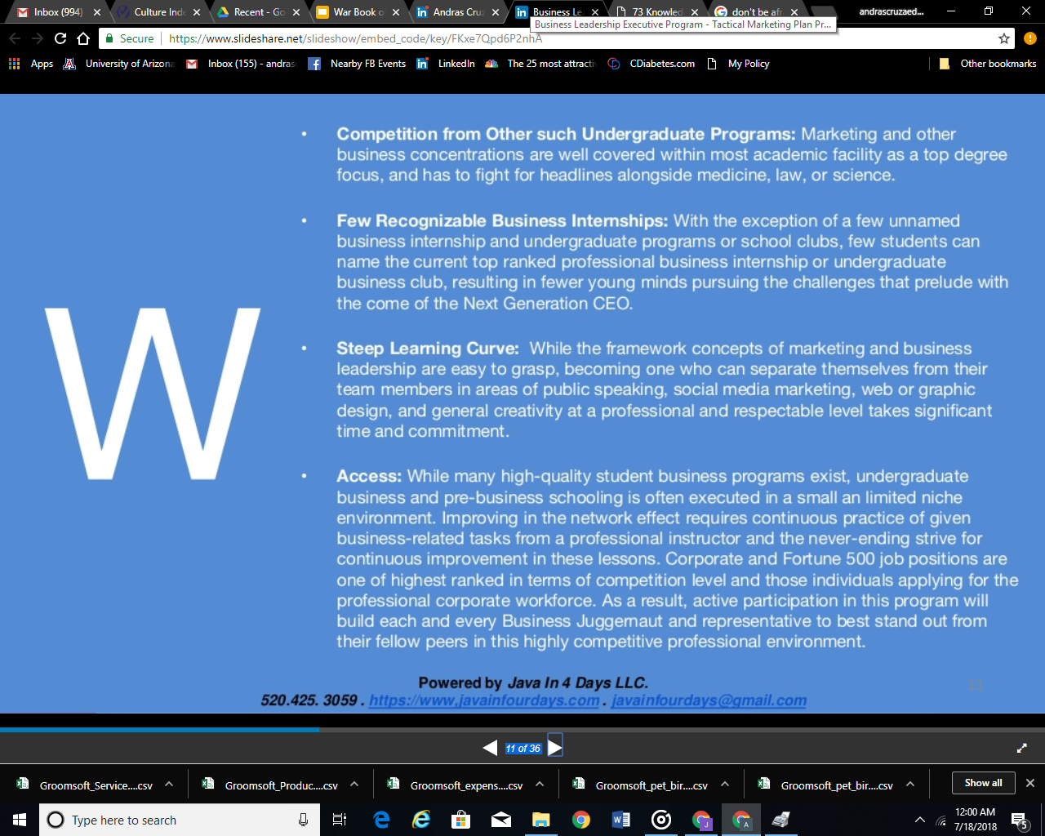
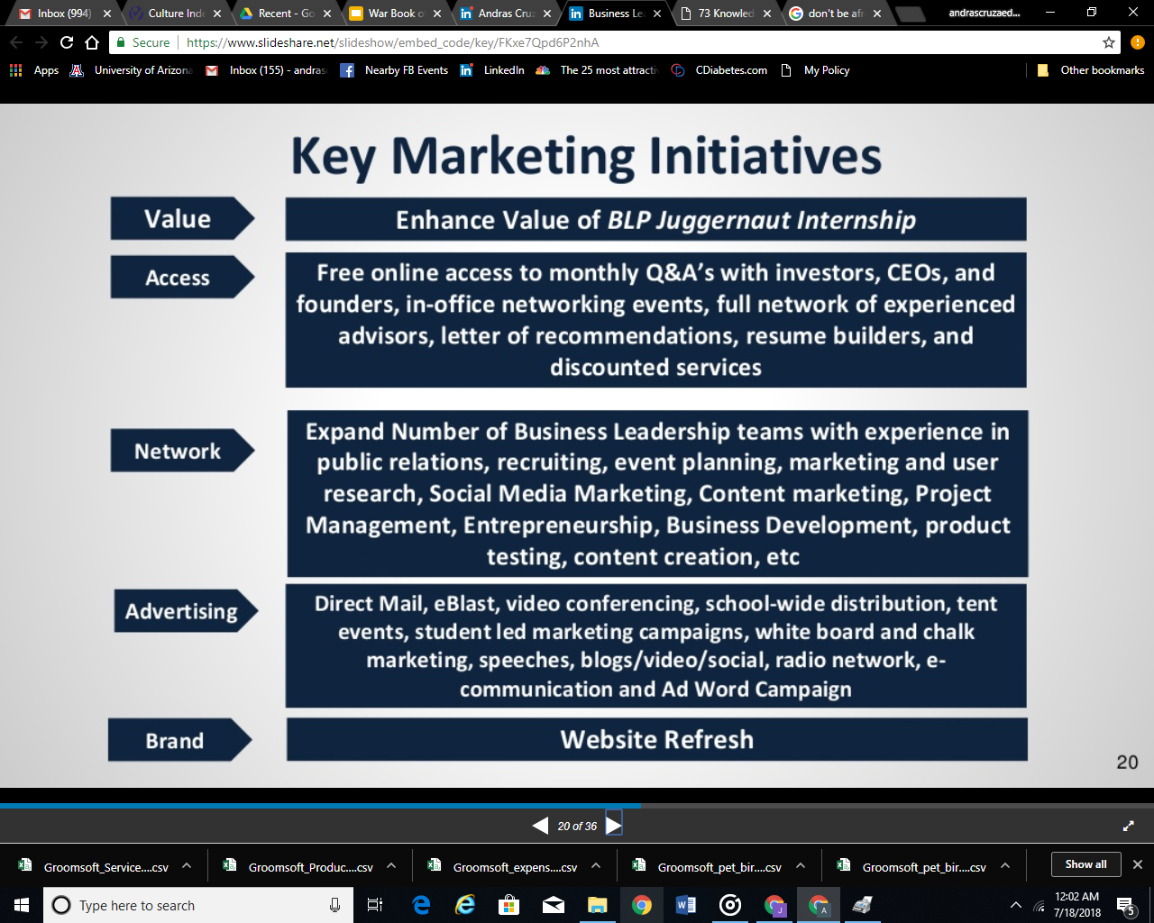
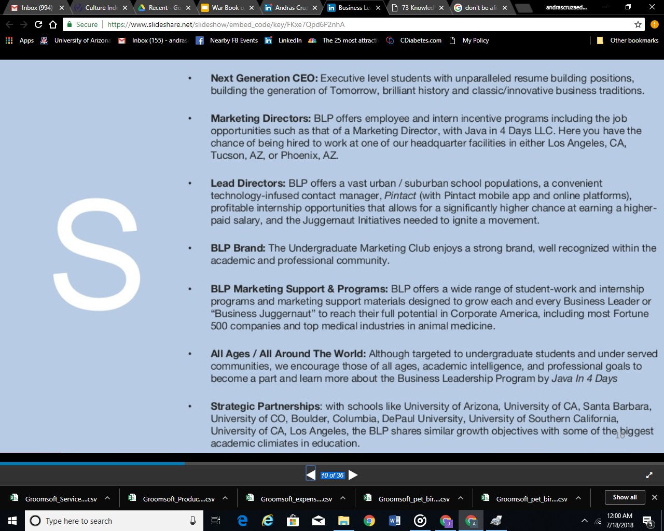
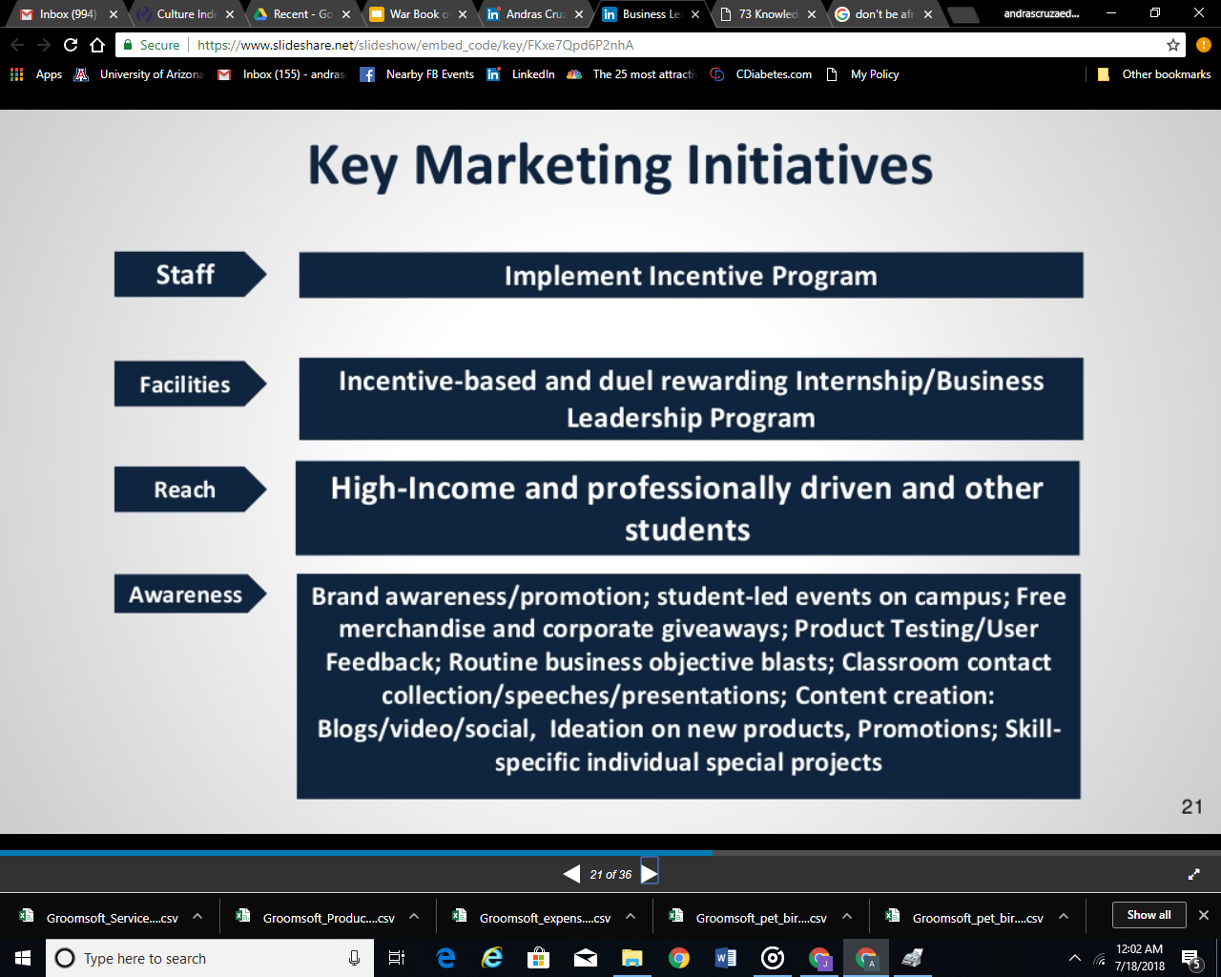
“Don’t be afraid to fail. Be afraid not to try.” - Michael Jordan
☆ Wrote the business plan for my grandfather’s startup that partnered with $9.1B VCA and increased his clientele from 160 total customers (Q4 2015) to 600 total customers (Q3 2018)
☆ Since 2015, I have used a consultative-approach to grow a small-sized startup for a veterinarian and, as a result, he was bought out and, as a result. has contracted with the new owners that I receive $250 every month, now, and until January of 2021

Slide 12
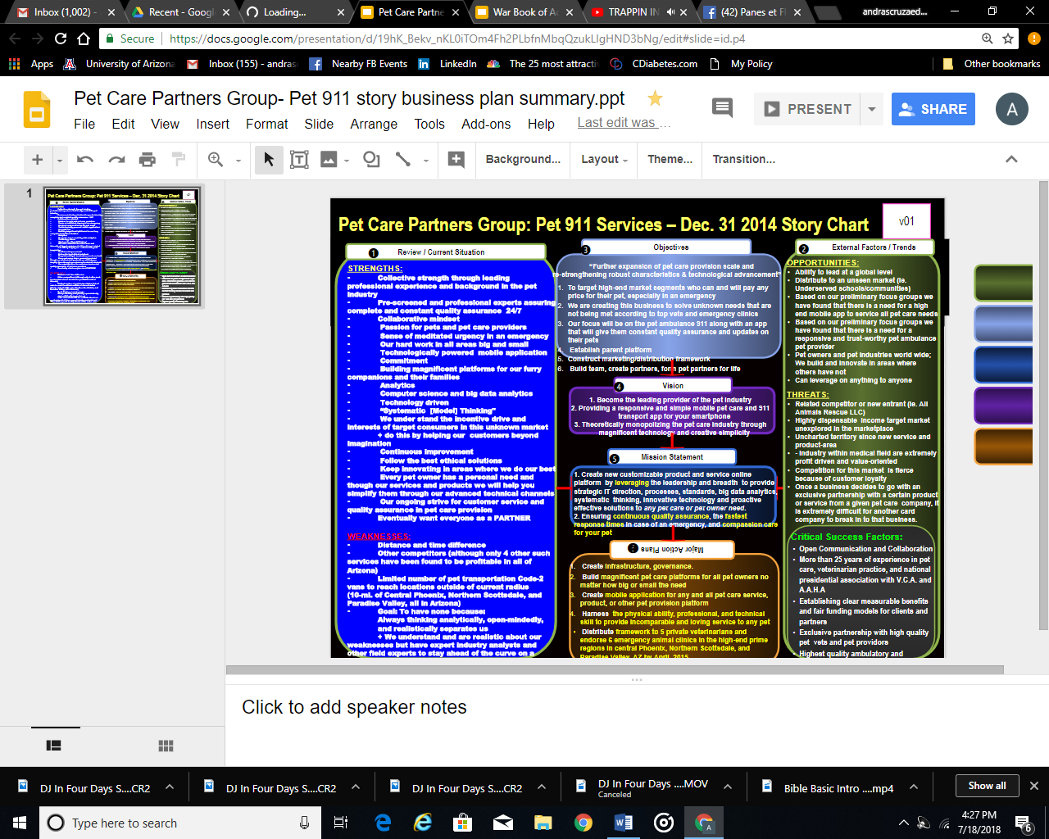
“In this competitive world of business development, strategic partnerships are essential!” - Tallwave, Inc.
☆ For client and retired veterinarian Dr. Vajda, I facilitated sales, “hi-tech”, and marketing resources for clients and partners, implemented their sales and marketing plan, presented client-facing sales proposals, and installed and configured softwares. This indirectly resulted in a corporate partnership with VCA Inc. to increase their clientele by 30%-40% (Q3 2015).

Slide 13
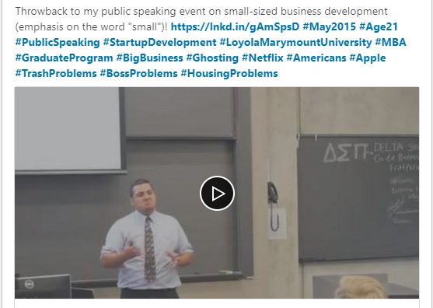
“Time crunches can make or break a company unless you’ve got the right team behind you!” - Tallwave, Inc.
☆ Asked by Oracle veteran Jeff Covert and my father to speak publicly in front of their MBA class at Loyola Marymount University (LMU)
☆ Topics included:
Forming a team of passionate experts
Sustaining a competitive business model
Significant financial backing
Growth
Scalability

Slide 14

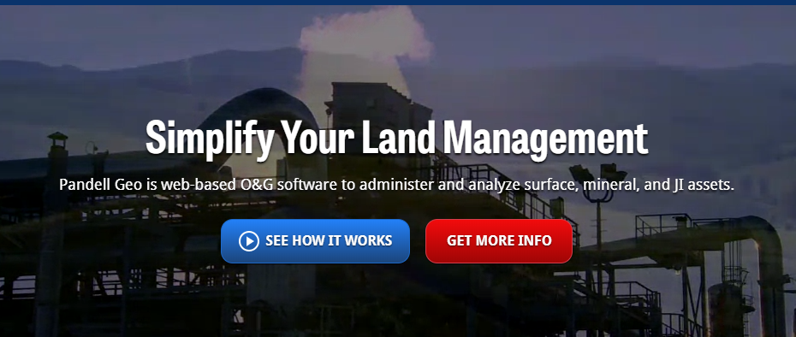
With a consultative approach, I researched and recommended Software-as-a-Service for Enercor Inc.
☆ Steve Powers, founder of Enercor, Inc. asked me to research, test, and report a cloud-based oil and gas software suitable for Enercor’s needs.
After running a modified decision-analysis model, I discovered that Pandell Geo would be the best option for Enercor.
After speaking with analytic software companies such as SAS and Agile Tech, Enercor choose to proceed with my recommendation.

Slide 15
Java in Four Days, LLC.
Professional Experience #3

Slide 16
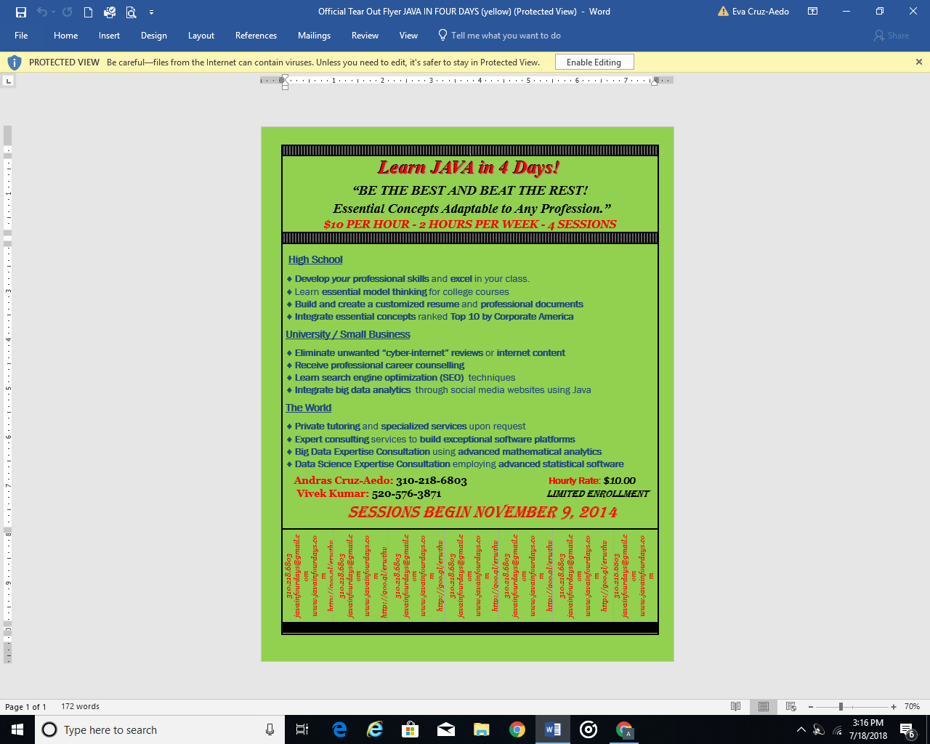
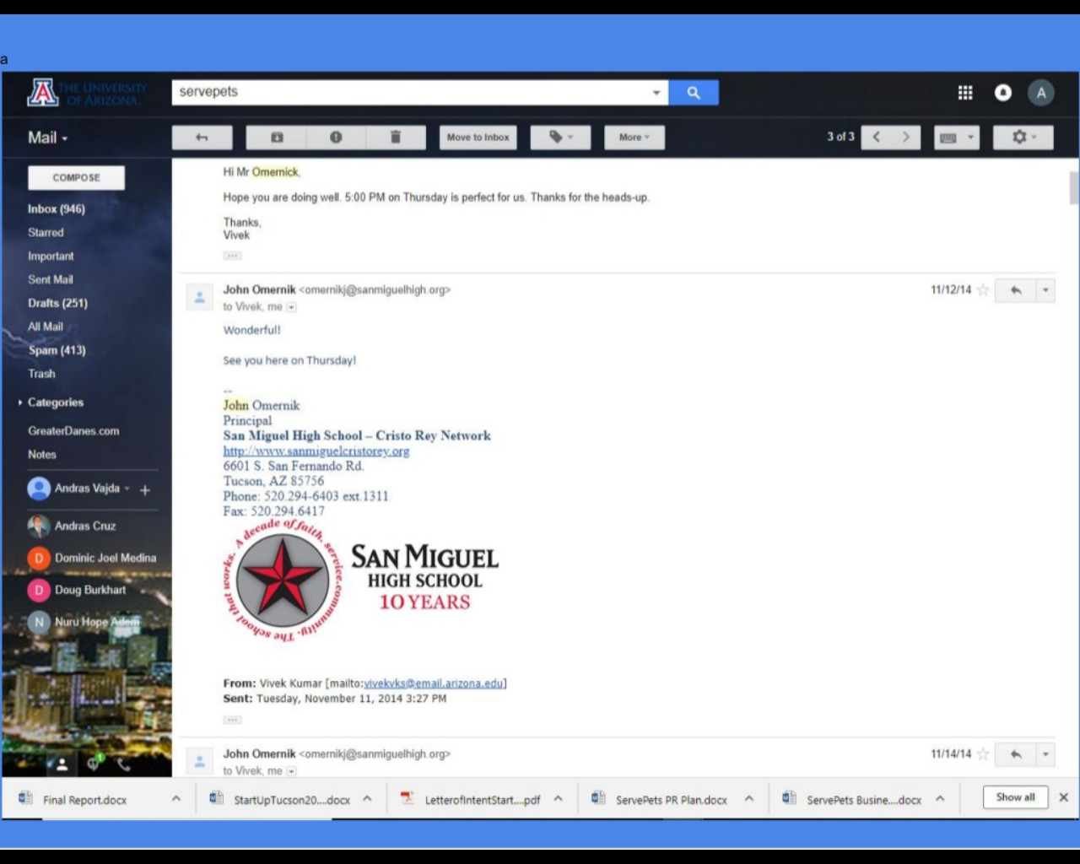
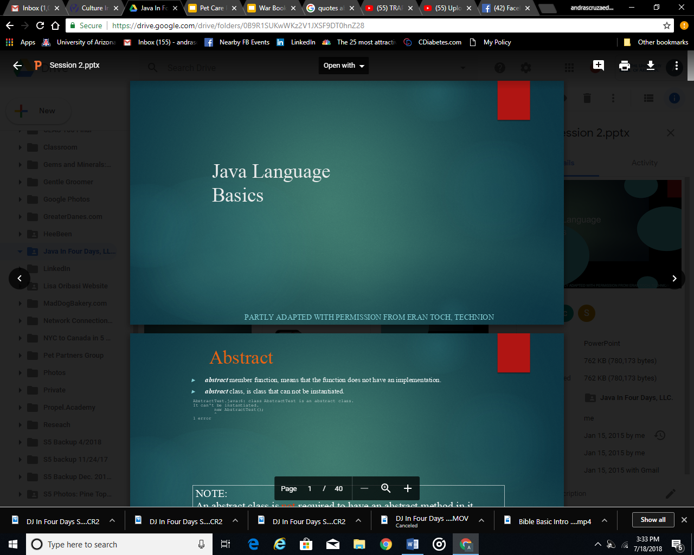
“The only thing to do with good advice is to pass it on.”
- Oscar Wilde
☆ Java in Four Days, LLC. (Ji4D) originally founded as an e-Learning and Education platform for those who did not know how to effectively market their own business (i.e., formed curriculum for Java-coding classes for San Miguel High School)
☆ I then adopted this business model to other business owners who lacked the time, knowledge, and technical resources to design and optimize their online presence

Slide 17
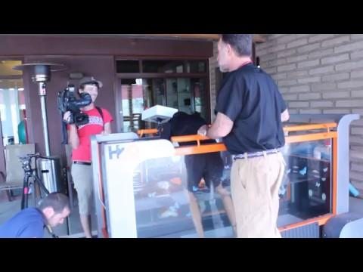
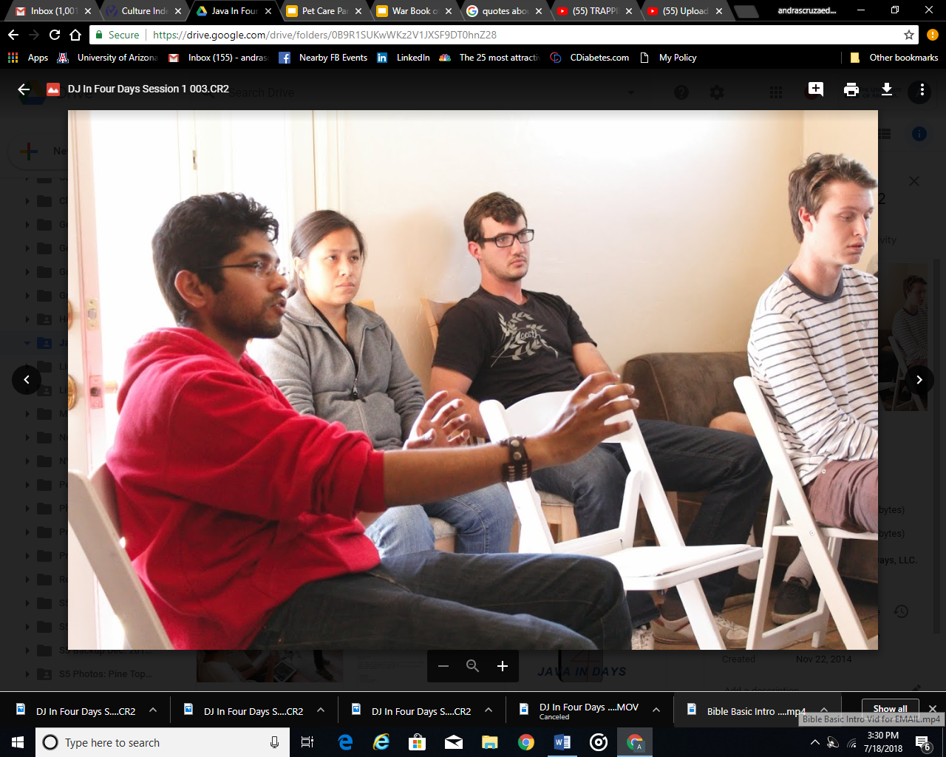
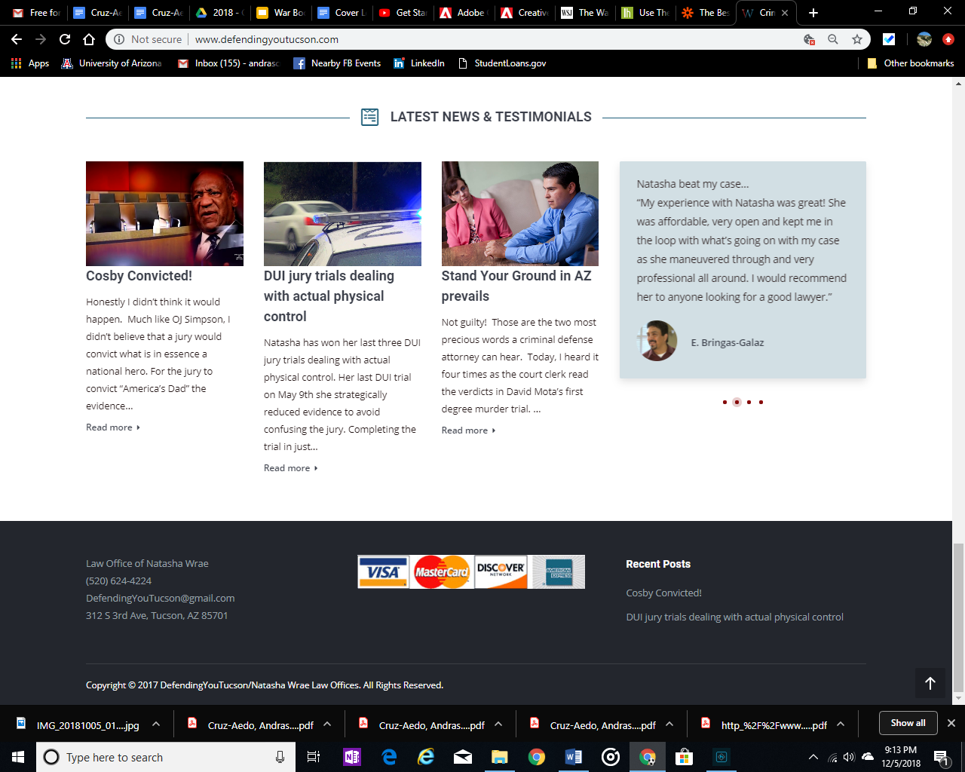
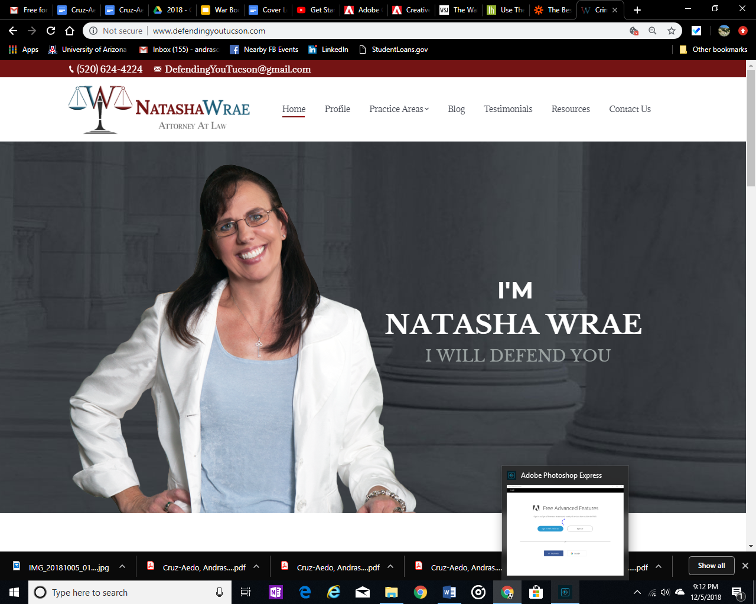
“Every vital organization owes its birth and life to an exciting and daring idea.” - James Bryant Conant (American Scientist)
☆ Evolved into website design and other digital marketing services for small to medium-sized enterprise (i.e., Dr. Randy PetVet, Emergency Animal Clinic, National Safety Traffic School, DefendingYouTucson.com, ServePetsLLC.com…)

Slide 18
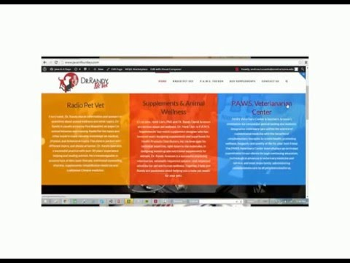
Technology is quickly evolving and small businesses must follow suit to keep pace. Read below to learn more!
☆ Our marketing and search visibility firm, Java in Four Days, LLC. (Ji4D), offers comprehensive e-marketing and data analytics services tailored to fit business needs
☆ Ji4D was formed by an MBA & MIS grad student, an attorney, and Blackboard Inc. veterans with over 40 years of combined experience with companies including JP Morgan, Goldman Sachs, and Blackboard, Inc.
CLICK PLAY

Slide 19
Solplicity (acquired by Cydcor, Inc.)
Professional Experience #4

Slide 20
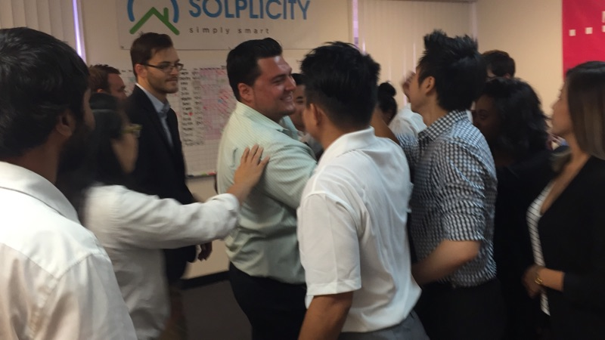
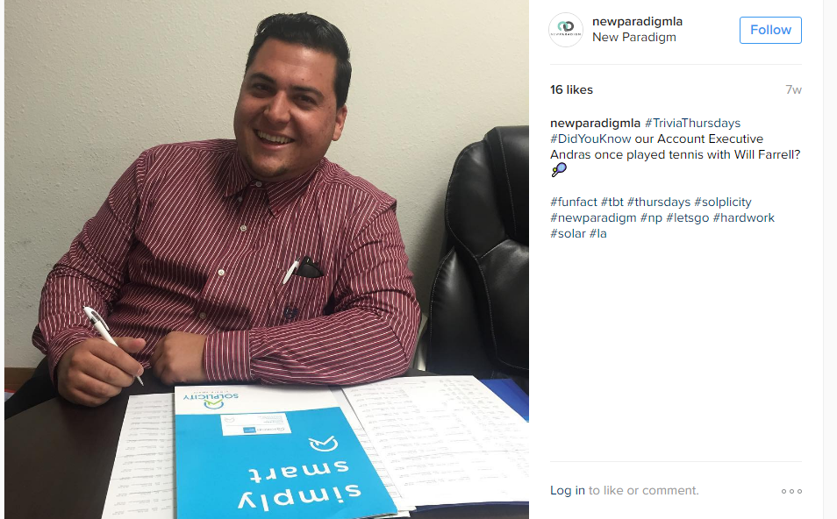
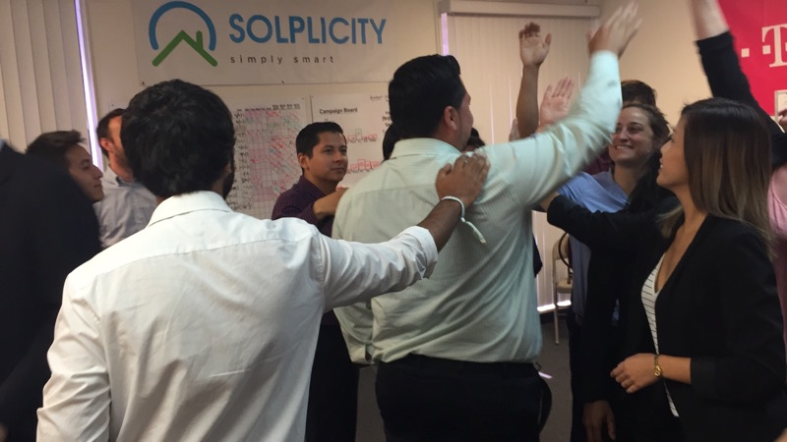
Andras hits promotion numbers in his first 8 weeks!
☆ With my knocking door-to-door on 100 homes per day and setting meetings with home-owning decision makers, and with Solplicity’s impressive training and leadership program, I was able to consistently close 8-week long value positions
☆ Generated $200,000 in total revenue (Q3 2016) and $250,000 in total revenue (Q4 2016)
☆ 2x Top Seller out of 30 co-workers

Slide 21
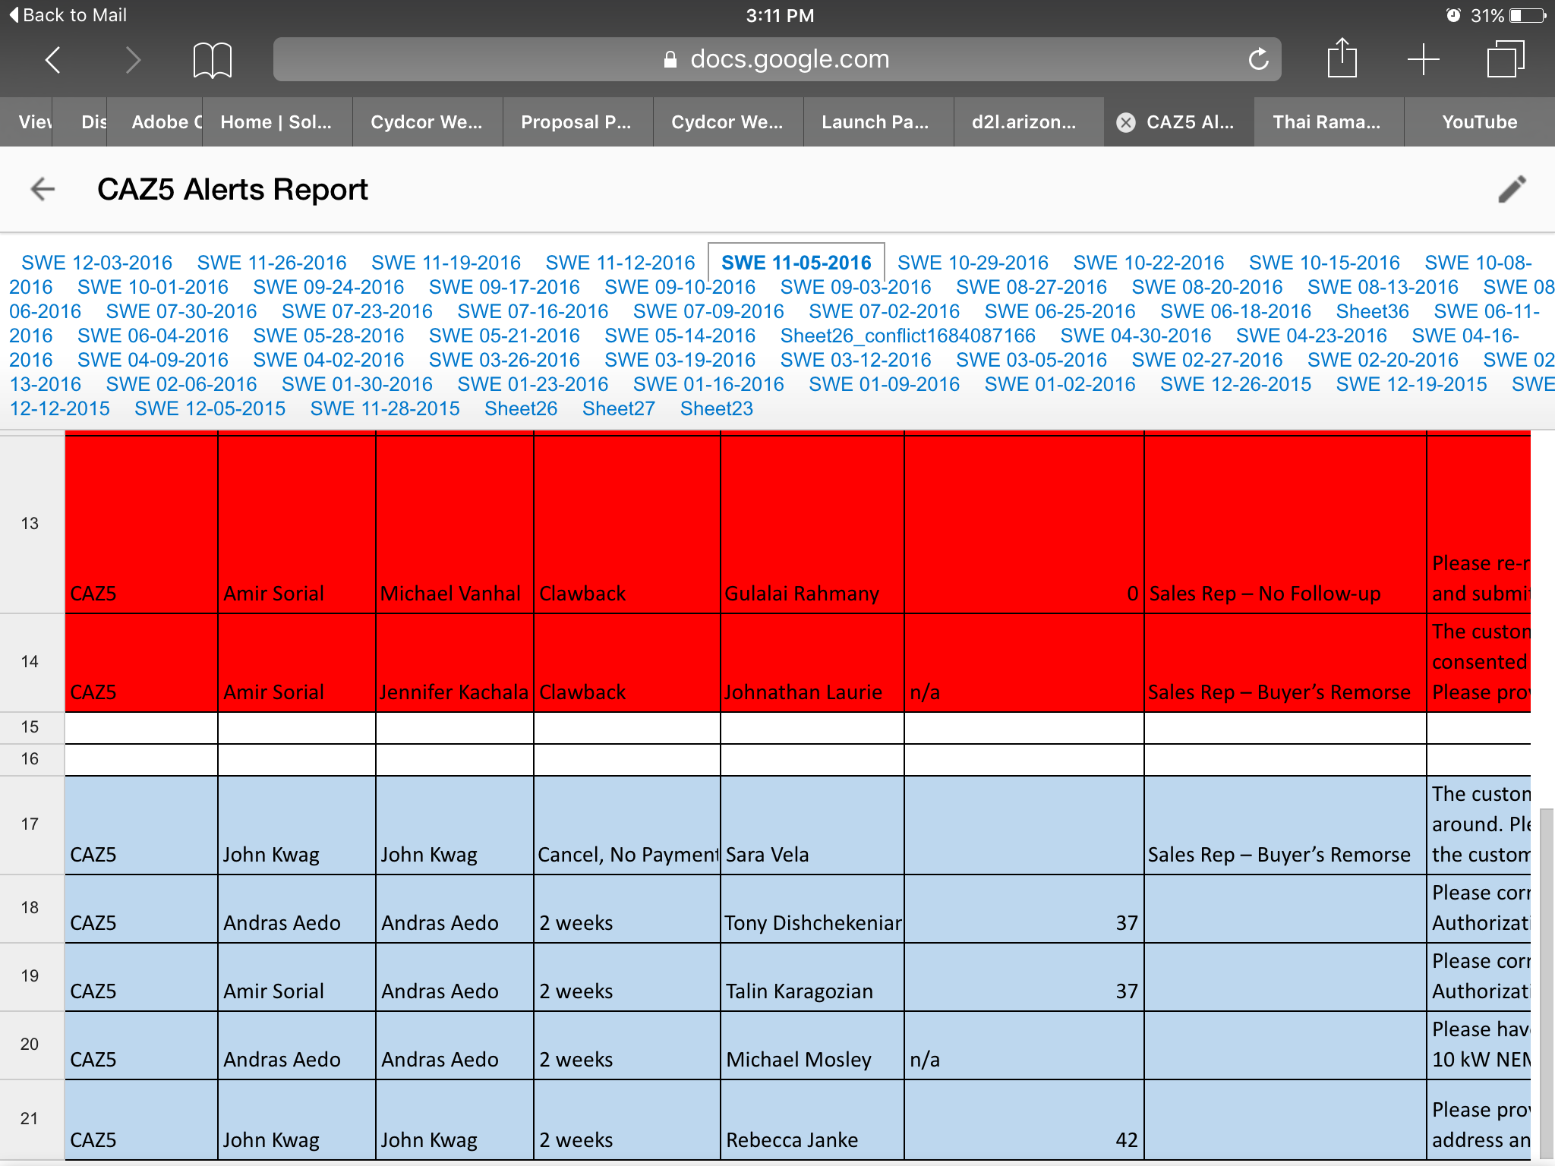
Top Performer: “Andras is this week’s High Roller!”

Slide 22
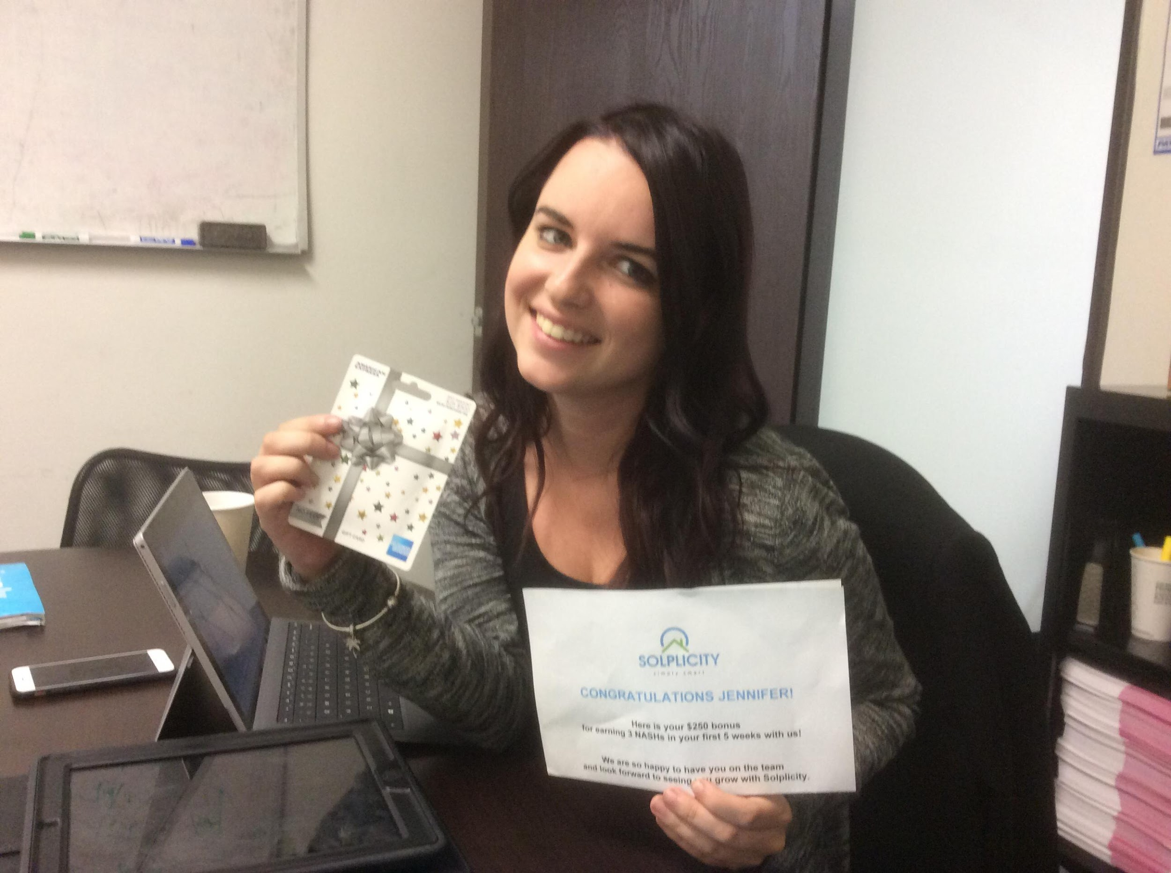
“Share your knowledge. It is a way to achieve immortality.”
― Dalai Lama XIV
☆ Trained my first team member, Jennifer “Jen” Kachala, and taught her close three solar accounts in her first five weeks
☆ Jen was then promoted to “Closer” in her first 6 weeks
☆ Secured and, twice, surpassed sales quotas, all while teaching “new hires” how to build their own strategic pipelines and how to best utilize our ZOHO customer relationship manager (CRM) software on iPad

Slide 23
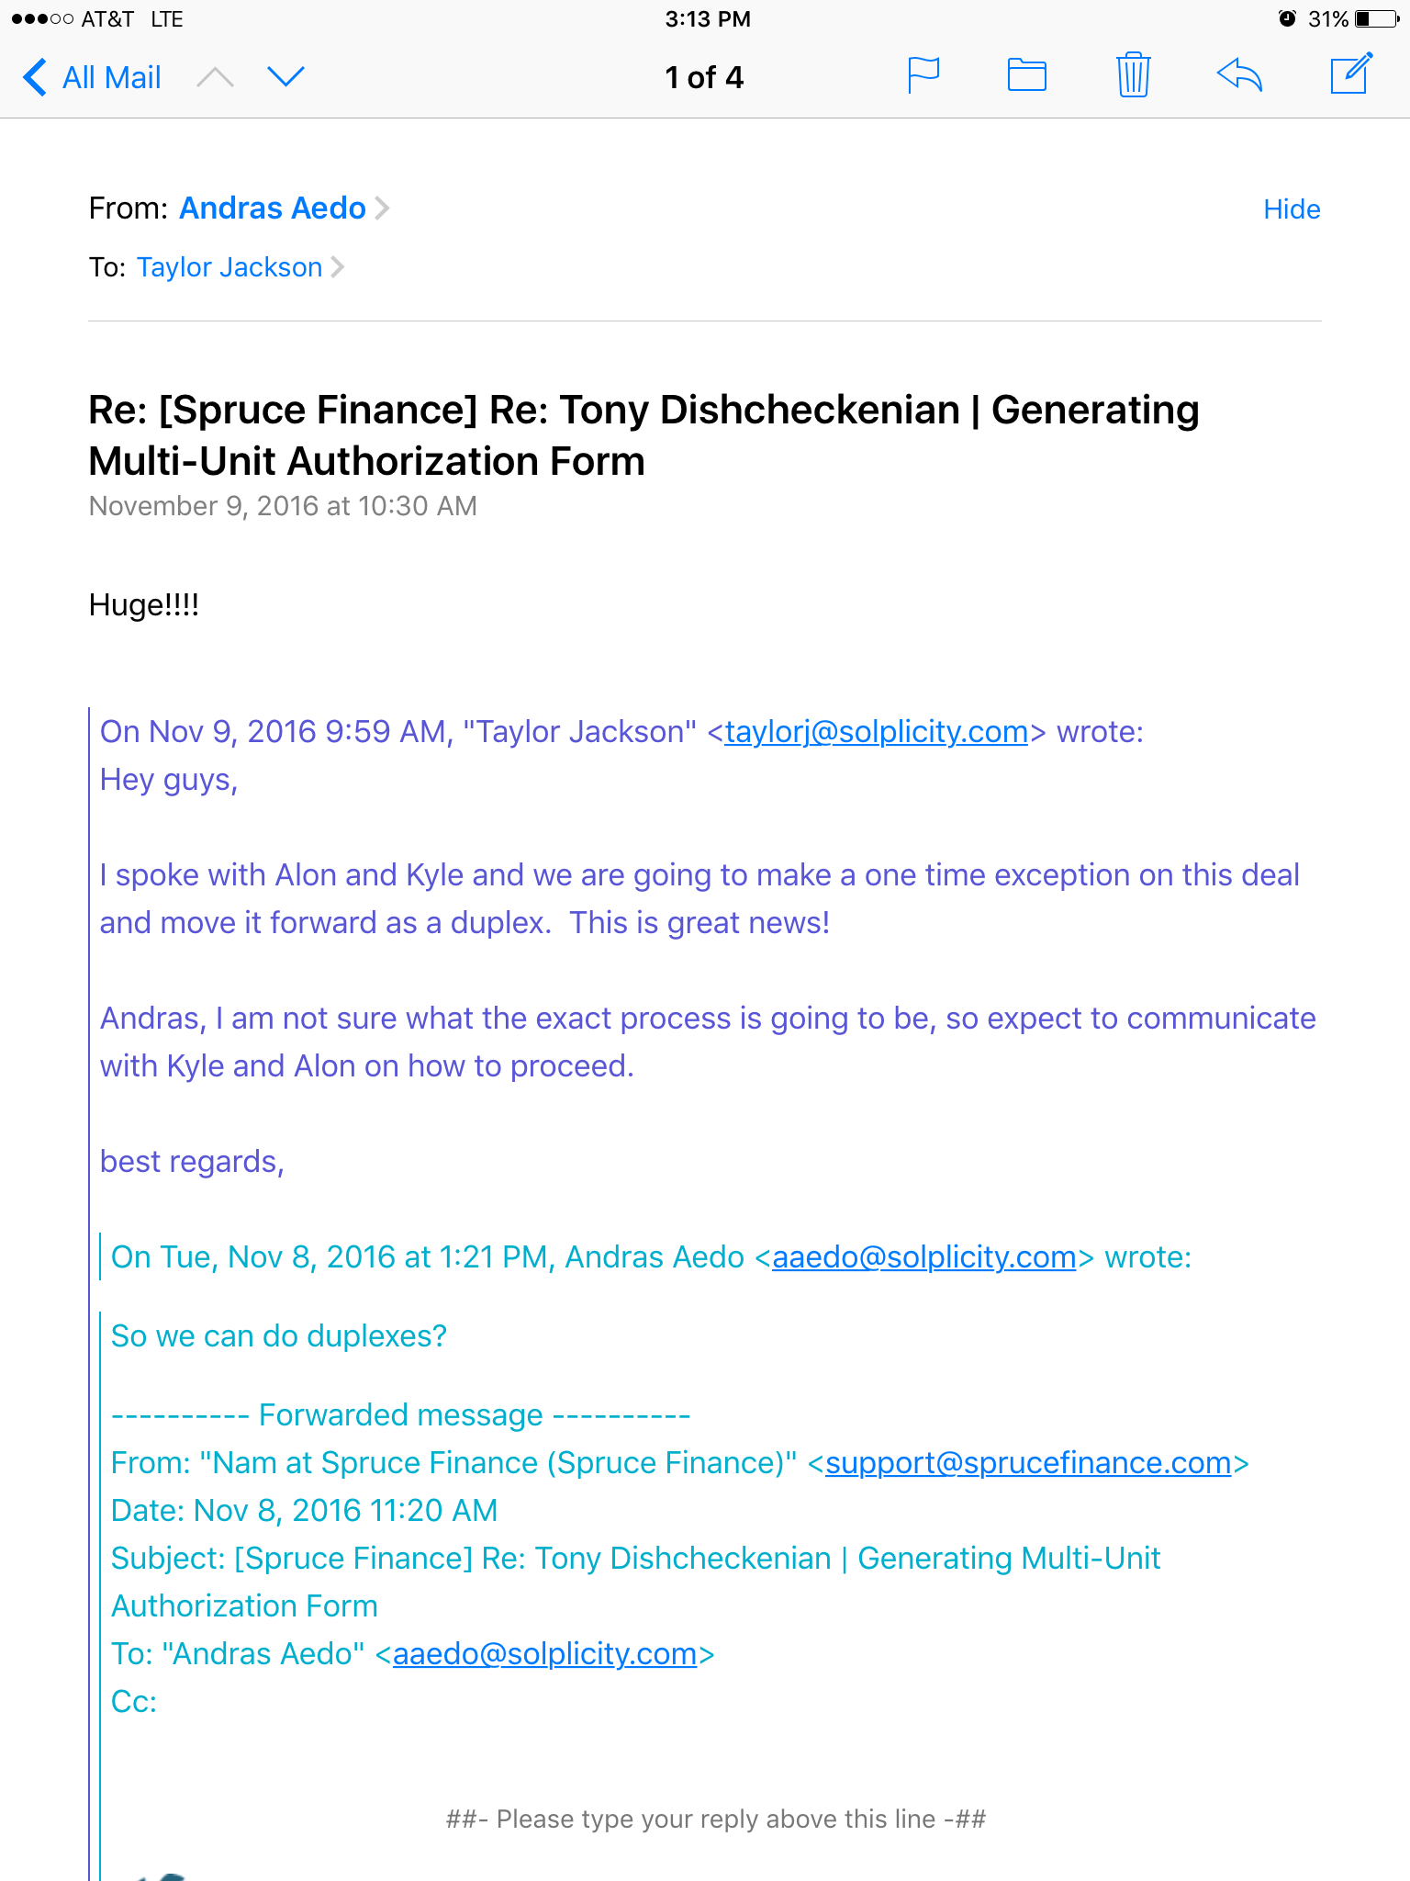
Activated new business for Solplicity!
☆ Whereas our company was only just adding commercial properties to their base of customers, I was lucky to be the first salesman to close a duplex as well as a condo deal
☆ This accomplishment, according to Solplicity’s president, Taylor Jackson, was shared in-person, online, and with executives of Cydcor Inc.

Slide 24
The End
Thank you for taking the time to watch this!

